Slide 1
Lecture 33

Slide 2
Question 123.14.1.5
A car is driving down I-20 at 70mph (the new speed limit). Does the center of mass of the car have the same kinetic energy as a piston in the engine?
Yes
No
Maybe
Wait, the speed limit changed?

Slide 3
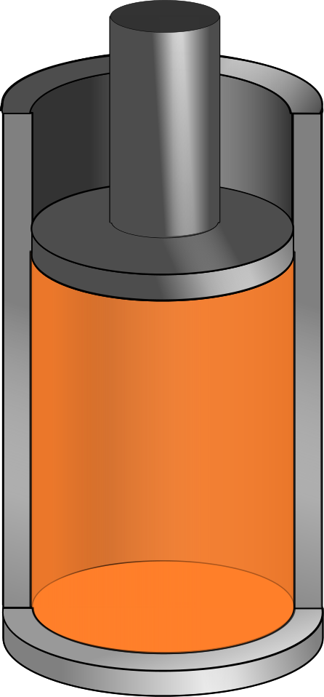
v_{system}
v_{molecule}
V
P
n
T

Slide 4
Question 123.14.1
We have two gases, each with the same values of n, V and T. One gas is Hydrogen, the other is Nitrogen. For which gas is the rms speed larger?
Hydrogen
Nitrogen

Slide 5
Question 123.14.2
If the temperature increases, the peak of the Maxwell-Boltzmann speed distribution
Increases to a higher velocity
Decreases to a lower velocity
Stays the same
Can’t tell

Slide 7
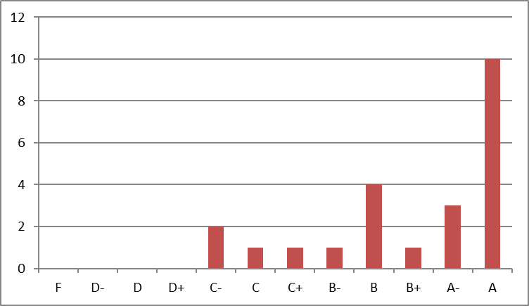
Number of students whose score was between 90 and 93
Number of students whose score was between 83 and 87

Slide 8
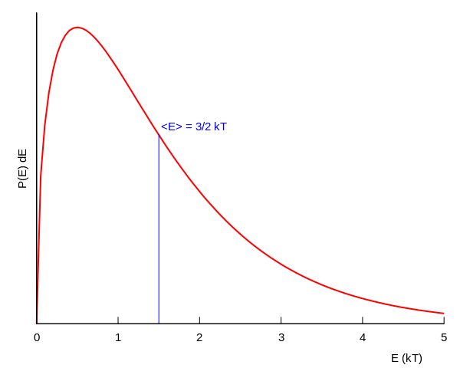
Boltzmann Distribution

Slide 9
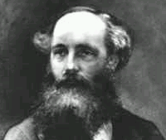
Found an expression for the Molecular Speed Distribution
James Clerk Maxwell (1831-1879)

Slide 10
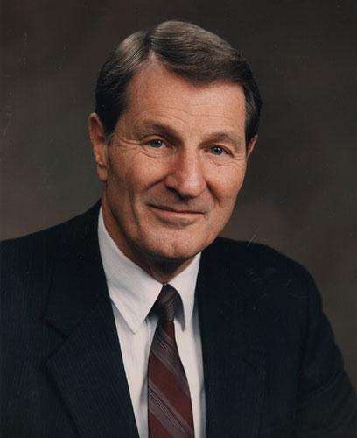
Not the same guy
Neal A. Maxwell
(1926-2004)

Slide 11
dv
v

Slide 12
N - total number of molecules

Slide 13
Question 123.14.2
If the temperature increases, the peak of the Maxwell-Boltzmann speed distribution
Increases to a higher velocity
Decreases to a lower velocity
Stays the same
Can’t tell

Slide 14
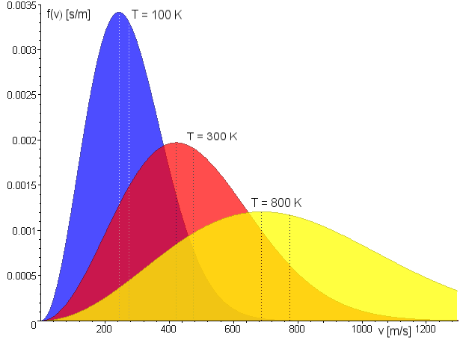
Maxwell Distribution
A system of gas at a given temperature will exhibit a variety of speeds
Three speeds are of interest:
Most probable
Average
rms
Image in the Public Domain couracy Fred Stober

Slide 15
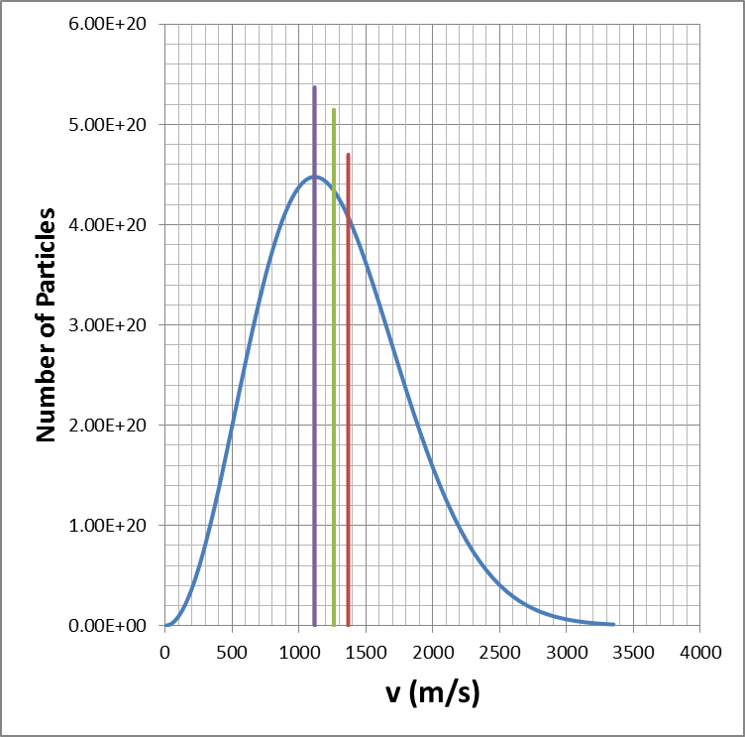
Molecular Speeds

Slide 16
Thermo Systems
Sample at known temperature T_{x}
Water temperature rises
Water at known temperature T_{w}
Insulated container

Slide 17
Thermo Systems
Surroundings
Surroundings
Surroundings
System
Insulated container
Surroundings

Slide 18
Thermo Systems
System Boundary
Surroundings
Surroundings
System
Surroundings
Surroundings

Slide 19

Vacuum
Membrane
Membrane
Gas at T_{i}
Gas at T_{i}

Slide 21
END

Slide 22
Question 123.17.1
The useful work that comes from and engine is equal to
-W
Q
ΔE_{int}
PV

Slide 23
Δx
P
F_{gas}
F_{external}
Q
V
V_{i}
V_{f}

Slide 24
Hot Reservoir at T_{h}
Q_{h}
Q_{c}
Cold Reservoir at T_{c}

Slide 25
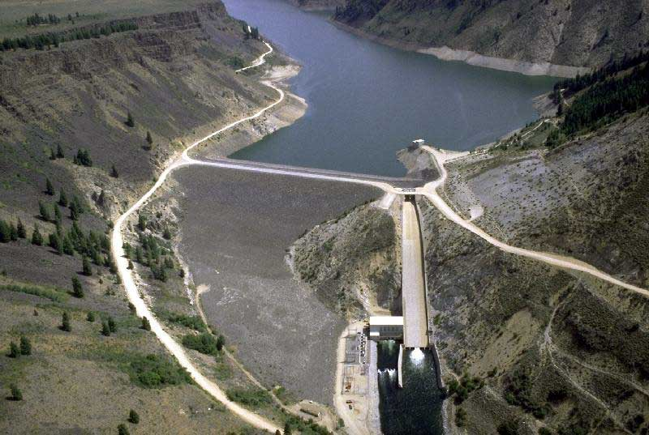
The picture shows the Anderson Ranch Dam and Reservoir.
If I take out a cup of water out of the reservoir, how much do the volume and the pressure of the water change?
Volume goes up, pressure down
Volume goes down pressure goes up
c) Volume goes down pressure goes down
d) You wouldn’t notice any difference

Slide 26
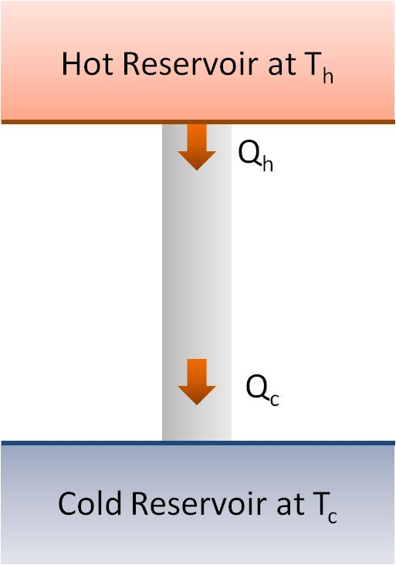
Question 123.17.2
By how much does the temperature of the hot reservoir change as Q_{h} leaves?
0K
10K
100K
1000K

Slide 27
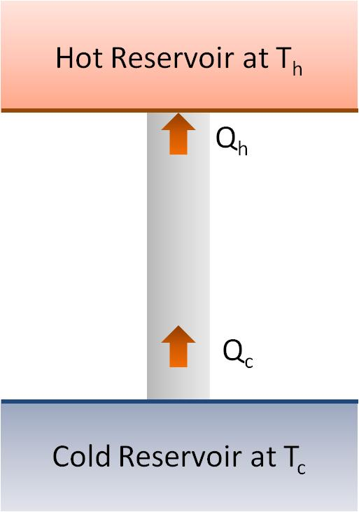
Question 123.17.3
What would you call the process shown in the energy transfer diagram
Adiabatic
Isobaric
Isothermal
Impossible

Slide 28
Question 123.17.4
What does the energy transfer diagram mean?
Heat is turned into useful work
Work is turned into waste energy
Energy is turned into useful work
This is an impossible process

Slide 29
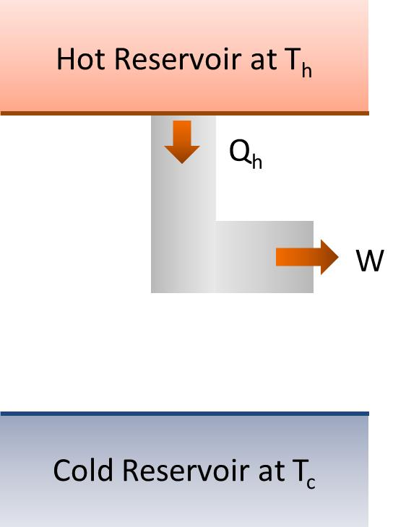
Question 123.17.4.5
What would you call the process shown in the energy transfer diagram
Adiabatic
Isobaric
Isothermal
Impossible

Slide 30
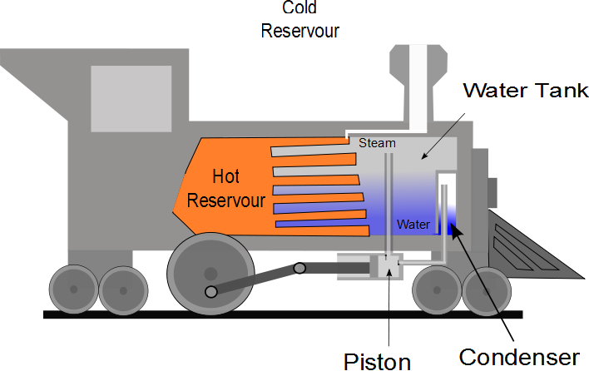

Slide 31
P
W_{eng} = Area
V

Slide 32
Question 123.17.5
Suppose I tell you I have an engine that has and efficiency e=1, what is Q_{c} for this engine?
0
W_{eng}+ Q_{h}
W_{eng}- Q_{h}
W_{eng}

Slide 33
Question 123.17.6
If I tell you I have a heat engine which operates with Q_{c} = 0, what should you do?
Buy Stock in my company
See if you can get your hands on the secret plans
Applaud the wonderful engineering achievement
Tell me I am lying (Kindly, this is BYU-I)

Slide 34
Question 123.17.7
It is a hot day. You don’t have and air conditioner, but you have a refrigerator. You open the door of the fridge. The air in your apartment
Gets cooler
Gets hotter
Stays the same
Can’t tell

Slide 35
Hot Reservoir at T_{h}
Q_{h}
Refrigerator
W
Q_{c}
Cold Reservoir at T_{c}

Slide 36
Hot Reservoir at T_{h}
Q_{h}
Q_{c}
Cold Reservoir at T_{c}

Slide 37
Hot Reservoir at T_{h}
Q_{h}
Q_{c}
Cold Reservoir at T_{c}

Slide 38
Hot Reservoir at T_{h}
W
Q_{c}
Cold Reservoir at T_{c}

Slide 39
Hot Reservoir at T_{h}
Q_{h}
W
Cold Reservoir at T_{c}

Slide 40
Hot Reservoir at T_{h}
Q_{h}
W
Cold Reservoir at T_{c}

Slide 41
Hot Reservoir at T_{h}
Q_{h}
Engine
W_{engine}
Q_{c}
Cold Reservoir at T_{c}

Slide 42
Hot Reservoir at T_{h}
Q_{h}
Engine
W_{engine}
Cold Reservoir at T_{c}

